Slide 1
Fractal Image Compression
Created by
Charles Fisher
Ty Emmert

Slide 2
Topics
What is fractal image compression
Important facts
Math behind fractal image compression
Properties of fractal image compression
Fractal image compression today
Notable programs that use fractal image compression

Slide 3
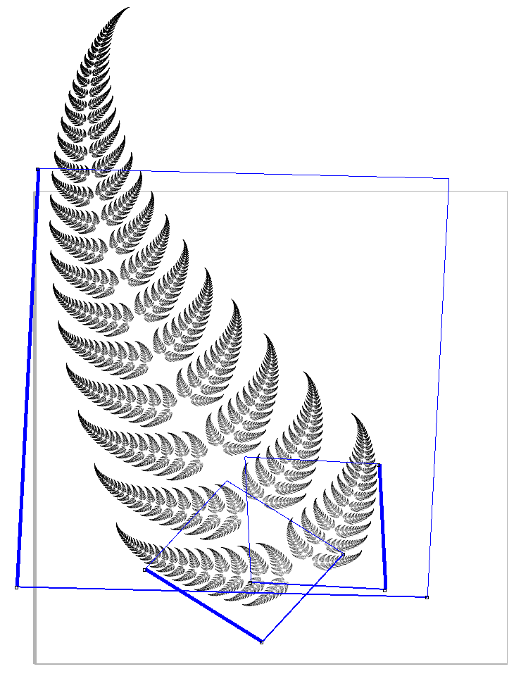
What is fractal image compression?
The compression of an image using fractal properties to map similar parts of a photo to each other using a series of affine transformations.
The image can then be iterated to achieve a high quality image.
Fractal image compression is NOT the compression of fractals.

Slide 4

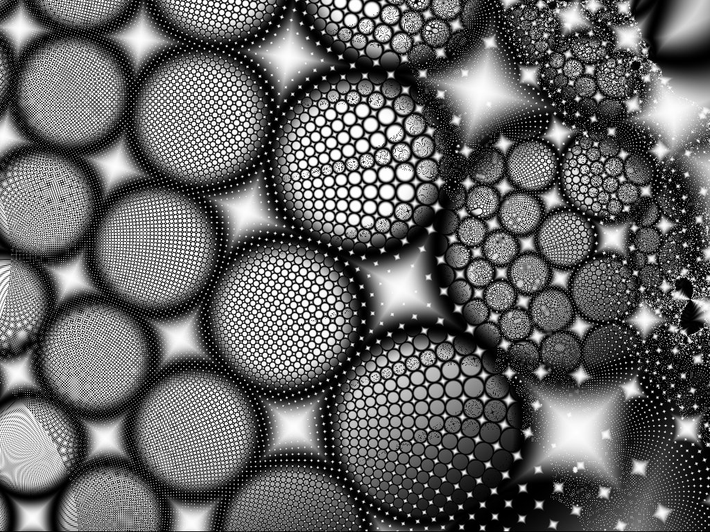
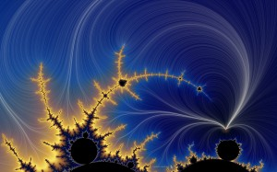
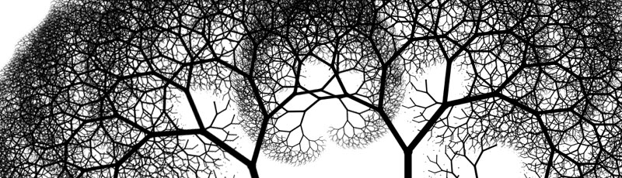
Fractals
A fractal has detail at every scale, is (exactly, approximately, or statistically) self-similar, and can be described by a simple algorithm.

Slide 5
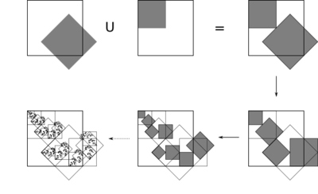
Michael Barnsley
Iterated function systems (IFS) were used to generate complex, natural looking images.
Barnsley came up with the idea that these systems could be reversed.
Example of an IFS

Slide 6
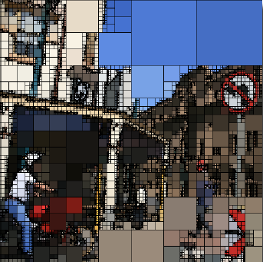
Mathematics
Quad-tree partition method
Divide an image into small, individual,
square blocks called parent blocks.
Divide each parent block into 4
child blocks
Compare each child block against
all parent blocks.
Choose the parent block of least
difference.
Use affine transformation to match
grayscale levels.
Quad-tree partition

Slide 7
Quad-tree explained further

Slide 8
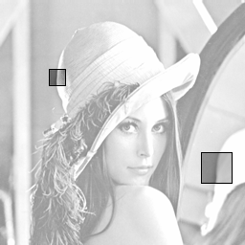
Compression
Compressing an image using quad-tree partition method.
Find similar blocks.
Compute affine transformation.
Store location of child block, parent block, and affine transformations.
Repeat for all child blocks.

Slide 9
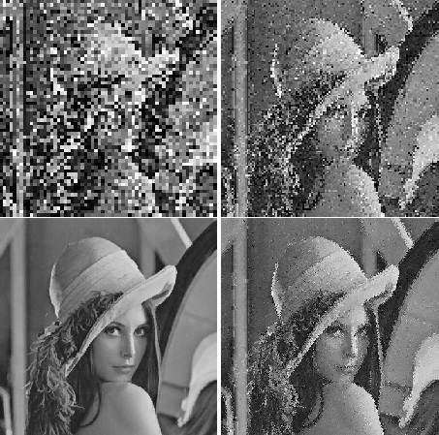
Decompression
Decompressing an image using quad-tree partition method.
Use a blank template of the same size as the original
Apply the affine transformations to each child block.
Discard old blocks as the system iterates and replace it with new blocks.
Repeat until acceptable quality is reached.

Slide 10
Properties of fractal image compression
For original compression techniques, the resolution is not included in the stored file.
This allows the image to be decompressed to any desired resolution (with side effects).
Zooming into a decompressed file shows its fractal properties
If a file is compressed well, it can be decompressed and zoomed-in without loss of much quality.

Slide 11
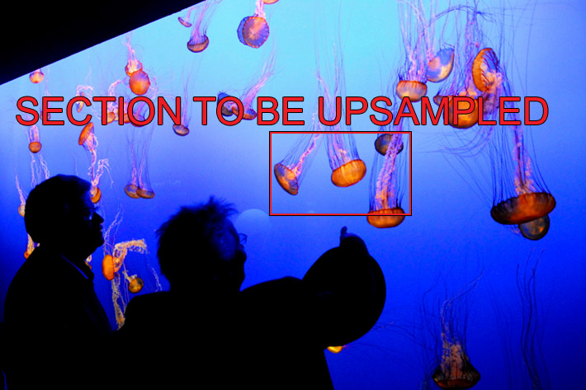
Using fractal image compression to zoom

Slide 12
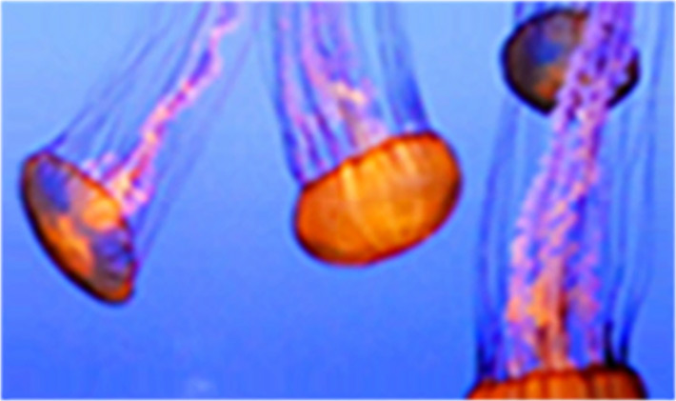
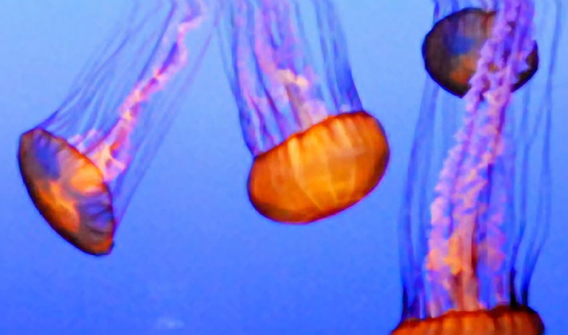
Results of 415% zoom
Original
Genuine Fractals Algorithm
Note: Higher quality zoom = bigger resolution potentials

Slide 13
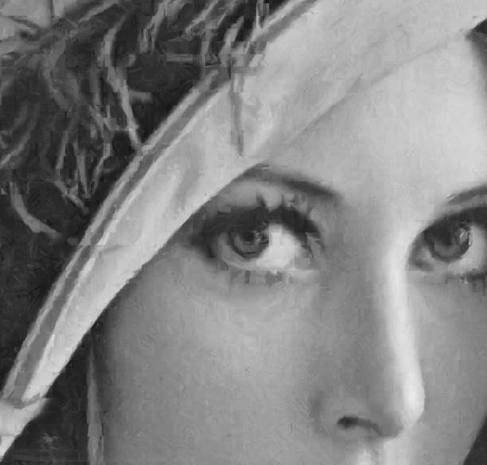
Fractals can be seen in the image after it has been decompressed

Slide 14
Fractal image compression today
Outdated fractal image files (.fif).
Was mostly used around windows 95 times.
Original file format for fractal images.
Outdated because of current computing power.
Programs that run .fif files haven’t been updated in years.

Slide 15
Fractal image compression vs jpeg
Fractal image compression wins:
Higher resolution.
Faster compression and decompression.
So why don’t we use fractal image compression?
The current computing power we have doesn’t make lower file sizes and faster compression times valuable aspects.
Fractal image compression is used in some things
Encarta multimedia encyclopedia
Photoshop

Slide 16
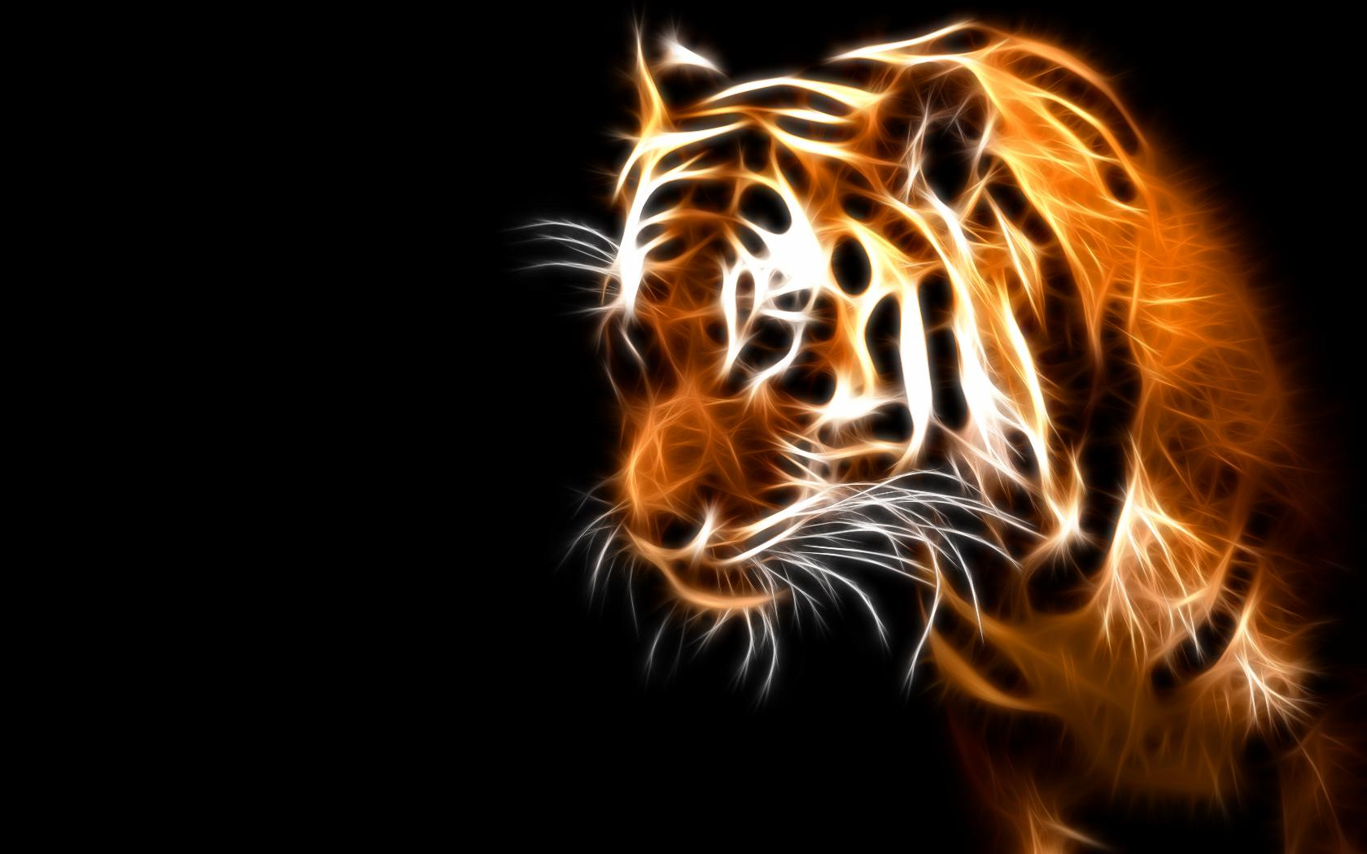
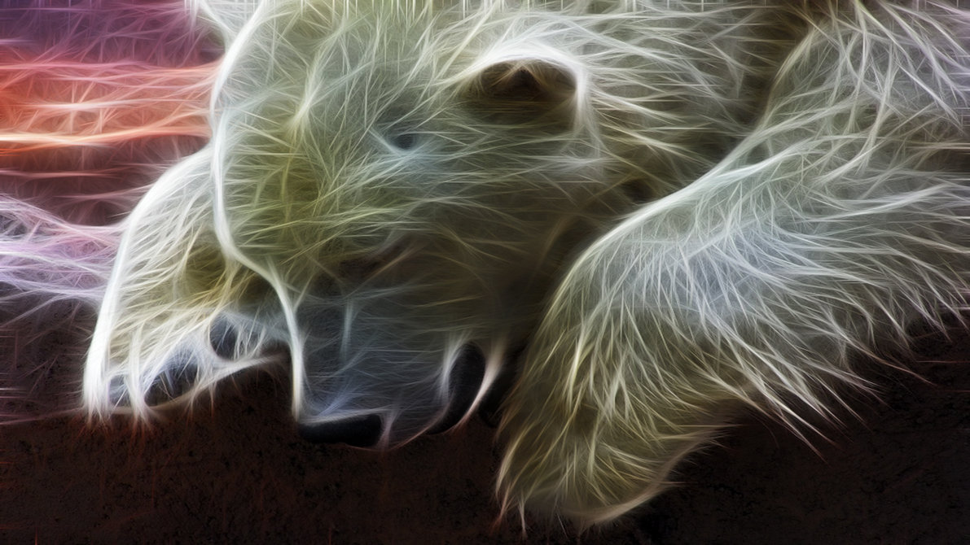
Photoshop
Fractalius plugin creates unusual, eccentric artworks in a single step. The effects are based on extraction of so-called hidden fractal texture of an image. You can also simulate various types of exotic lightings and high realistic pencil sketches.

Slide 17
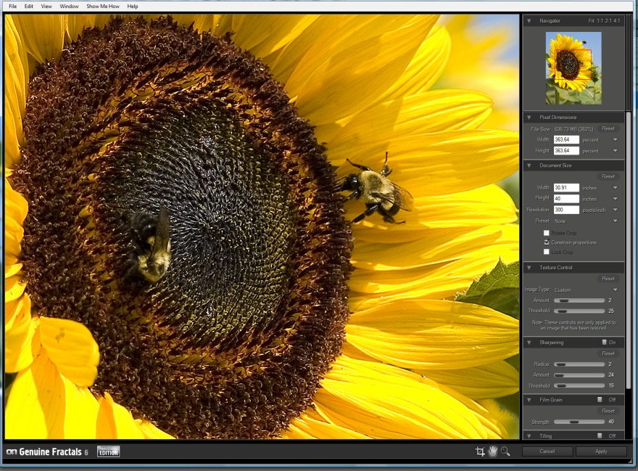
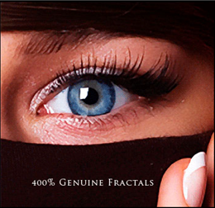
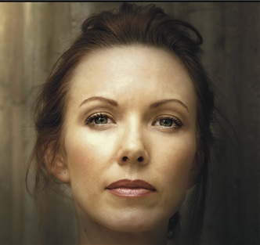
Photoshop
Genuine Fractals
file compression ratios around 2:1 for lossless and 5:1 for visually lossless.
Lossless – allows data to be perfectly reconstructed.
Increases image size while preserving detail.

